Slide 1

BAU GOLD PROJECT
Technical Presentation
Ray Shaw, CEO.
January 2022

Slide 2
Disclaimer
This presentation shall not constitute an offer to sell or the solicitation of an offer to buy nor shall there be any sale of the securities in any jurisdiction where such offer, solicitation or sale would be unlawful.
Forward Looking Statements
This presentation by Besra Gold Inc. (“Besra”) may include statements concerning future operations, prospects, strategies, plans, projections, forecasts, financial conditions and economic performance, as well as goals intentions and objectives, that are forward-looking statements within the meaning of the United States Private Securities Litigation Reform Act of 1995 or Canadian securities legislation. These statements are necessarily based upon a number of assumptions and estimates that, while considered reasonable by us, are subject to significant risks, uncertainties and contingencies, many of which are beyond our control. Known and unknown factors could cause actual results to differ materially from those projected in the forward-looking statements. Such factors include fluctuations in precious metal prices, unpredictable results of exploration activities, uncertainties inherent in the estimation of mineral reserves and resources, fluctuations in the costs of goods and services or in currency markets, problems associated with exploration, development and mining operations, changes in legal, social or political conditions in the jurisdictions where Besra operates, lack of appropriate funding and other risk factors, as discussed in Besra’s filings with Canadian and United States securities regulatory agencies. These filings are available by visiting the Securities and Exchange Commission's web site www.sec.gov or Besra's web site at www.besra.com Should one or more of these risks or uncertainties materialize, or should underlying assumptions or estimates prove incorrect, actual results may vary materially from those anticipated, believed, estimated or expected. All statements, other than statements of historical fact, are forward-looking statements. When used, words like “anticipates”, “expects”, “believes”, “forecasts”, “projects”, “estimates”, “seeks”, “plans”, “intends” and similar expressions are intended to identify forward-looking statements designed to fall within securities laws' safe harbors for forward-looking statements. Besra cautions readers not to place undue reliance on any such forward-looking statements, which speak only as of the date made and should not be construed as a guarantee of future performance. Besra disclaims any obligation to subsequently update or revise any forward-looking statements to reflect events or circumstances after the date of such statements or to reflect the occurrence of anticipated or unanticipated events. This presentation and the information contained herein do not constitute an offer or a solicitation of an offer for sale of any securities. None of the information contained herein is intended to be, and shall not deemed to be, incorporated into any of Besra’s or its affiliates' securities related filings or documents. We Seek Safe Harbor.
Qualified Person
Unless otherwise noted, the technical information in this presentation has been prepared and/or reviewed by Kevin Wright, General Manager – Bau Project of Besra Gold Inc, who is a Fellow of the Institute of Materials, Minerals and Mining (FIMMM), a Chartered Engineer (C.Eng), and a Chartered Environmentalist (C.Env). Mr Wright is a consultant to Besra and a Qualified Person as defined in National Instrument 43-101 of the Canadian Securities Administratorss, as well as a Competent Person under the JORC Code (see below). The Company employs a quality control program to ensure best practices in sampling and analysis of drill core and rock samples. Mr Wright reviews all assay results prior to public release.
Mineral resources that are not mineral reserves do not have demonstrated economic viability. Mineral resource estimates do not account for mineability, selectivity, mining loss, and dilution. These mineral resource estimates include inferred mineral resources that are normally considered too speculative geologically to have economic considerations applied to them that would enable them to be categorized as mineral reserves. There is also no certainty that these inferred resources will be converted to measured and indicated categories through further drilling, or into mineral reserves once economic considerations are applied.
JORC
Mr. Wright has sufficient experience which is relevant to the style of mineralisation and type of deposit under consideration and to the activity which he is undertaking to qualify as a Competent Person as defined in the JORC Code 2012 Edition of the “Australasian Code for Reporting of Exploration Results, Mineral Resources and Ore Reserves” as well as being a Qualified Person as defined in National Instrument 43-101 Standards of Disclosure for Mineral Projects of the Canadian Securities Administrators.
The resource figures for the Bau Gold Property have been prepared by Mr Wright is a full-time consultant to the Company and is not “independent” within the meaning of National Instrument 43-101. Mr Wright consents to the inclusion in this presentation of the information that he has compiled in relation to the Bau Gold Property, in the form and context in which it appears.

Slide 3
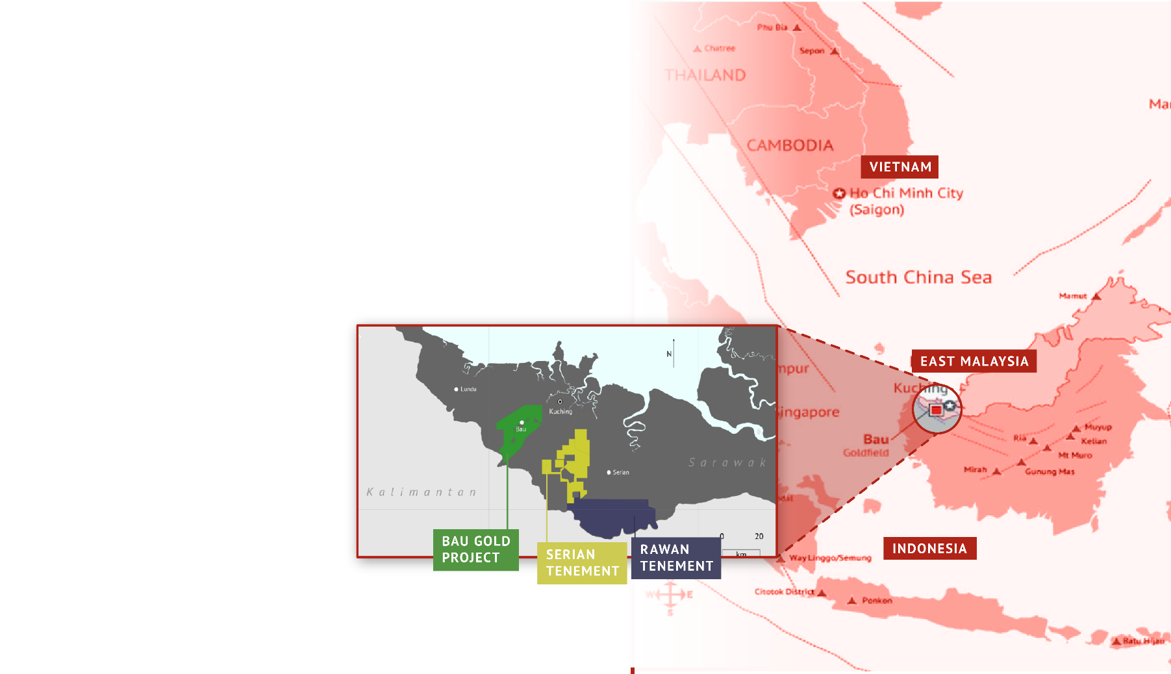
BAU GOLD PROJECT
LARGE RESOURCE INVENTORY 3 .3Moz JORC (2012) plus exposure to Exploration Target 4.9-9.3 Moz ¹
FOCUSED STRATEGY
+750m Resource drilling completed since Listing in October 2021.
Target 5 Moz -optimising pre-production strategies.
EXPERIENCED IN-COUNTRY TEAM
STABLE JURISDICTION
Ready access to infrastructure and skills base.
.
1. The potential quantity and grade of the Exploration Targets is conceptual in nature; there has been insufficient exploration to estimate a Mineral Resource and it is uncertain if further exploration work will result in the estimation of a Mineral Resource.
1

Slide 4
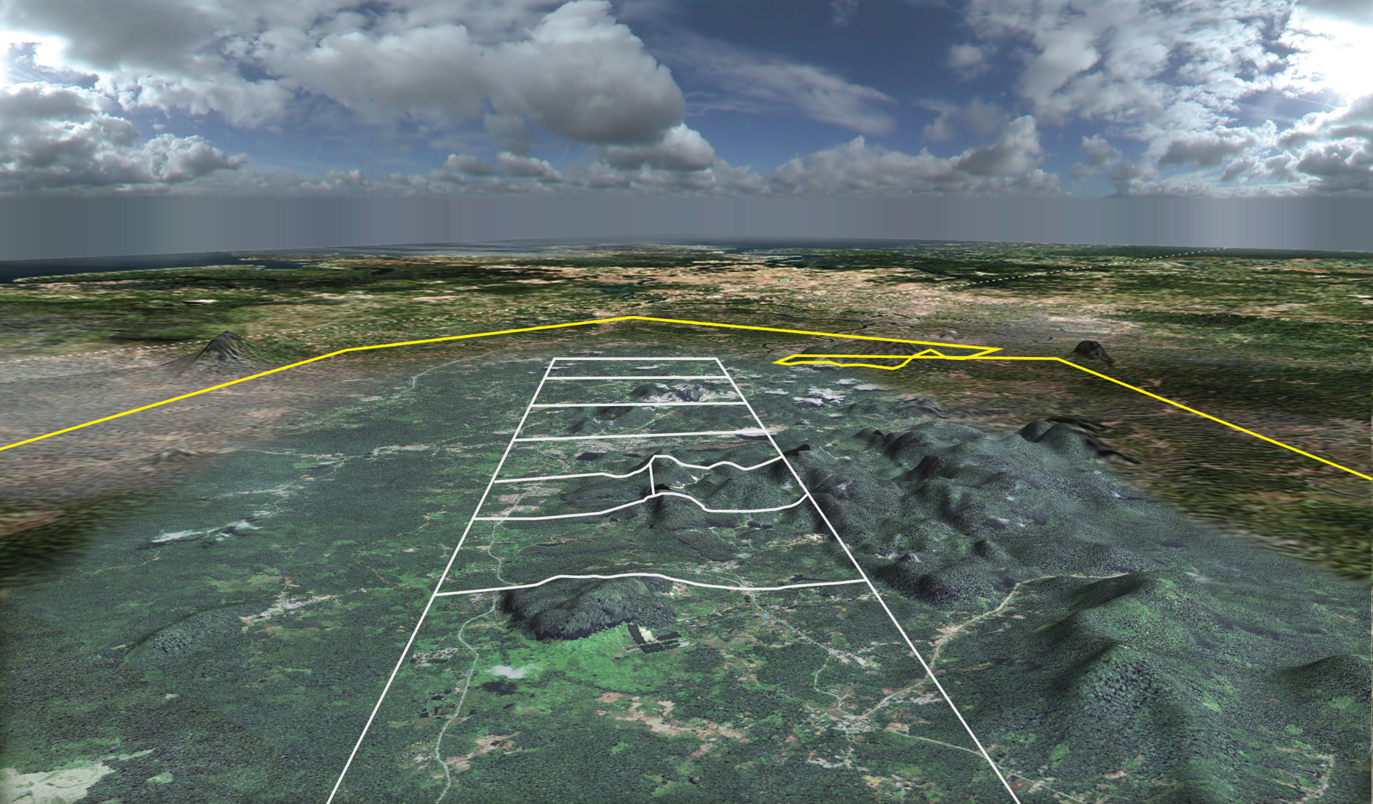

BAU GOLD PROJECT
Kuching City
(40 km)
Jugan
Bekajang
15 km
Pejiru
N
2
8 km
7

Slide 5
JORC 2012 Resource of 3.3 Million Ounces of Gold¹
 | Measured |  |  | Indicated |  |  | Total Measured & Indicated |  |  | Inferred
Deposit | Tonnes (Mt) | G/t Au | Contained Au (‘000 Oz’s) | Tonnes (Mt) | G/t Au | Contained Au (‘000 Oz’s) | Tonnes (Mt) | G/t Au | Contained Au (‘000 Oz’s) | Tonnes (Mt) | G/t Au | Contained Au (‘000 Oz’s)
Pejiru | - | - | - | - | - | - | - | - | - | 25.8 | 1.2 | 997.8
Jugan Hill | 3.4 | 1.5 | 166.9 | 14.5 | 1.5 | 703.6 | 17.9 | 1.5 | 870.5 | 1.8 | 1.6 | 89.8
Sirenggok | - | - | - | - | - | - | - | - | - | 8.3 | 1.1 | 306.8
Bekajang | - | - | - | 1.9 | 2.0 | 120.4 | 1.9 | 2.0 | 120.4 | 10.6 | 1.5 | 524.1
Taiton | - | - | - | 1.5 | 2.8 | 134.5 | 1.5 | 2.8 | 134.5 | 3.4 | 1.8 | 192.9
Say Seng | - | - | - | - | - | - | - | - | - | 1.4 | 1.6 | 70.9
Total | 3.4 | 1.5 | 166.9 | 17.9 | 1.7 | 958.0 | 21.3 | 1.6 | 1,125.4 | 51.3 | 1.3 | 2,181.6
1 A potential impairment occasioned by the establishment of the Dered Krian National Park (“Park”) has a near-term adverse impact upon the Bau project, however, the bulk of the resources and reserve reduction remain external to the Park boundaries. Besra is working with the Department of Urban Development & Natural Resources to excise the Park land from the tenements. Alternatively, if tenements overlapping Park boundaries are cancelled, then Besra will lodge new tenement applications covering the land outside the Park, as necessary. This would result in the project’s global resource reducing to 3.03 Moz, with no impact on the reserve.
* Totals may not tally due to rounding of values.
3

Slide 6
JORC Exploration Target¹ of a further 4.9 to 9.3 Million Ounces
Deposit | Tonnage Range (Mt) |  | Grade Range (g/t Au) |  | Gold Potential (M Oz)
 | From | To | From | To | From | To
Pejiru | 30 | 42 | 1.76 | 2.44 | 1.7 | 3.3
Jugan | 34 | 40 | 1.82 | 2.50 | 2.0 | 3.2
Say Seng | 7 | 10.5 | 1.42 | 1.60 | 0.3 | 0.5
Sirenggok | 8 | 11.4 | 1.15 | 4.25 | 0.39 | 1.56
Bekajang | 8 | 9 | 2.0 | 3.0 | 0.50 | 0.80
Combined: | 87 | 112.9 | 1.74 | 2.55 | 4.89 | 9.27
1. The potential quantity and grade of the Exploration Targets is conceptual in nature; there has been insufficient exploration to estimate a Mineral Resource and it is uncertain if further exploration work will result in the estimation of a Mineral Resource.
4

Slide 7

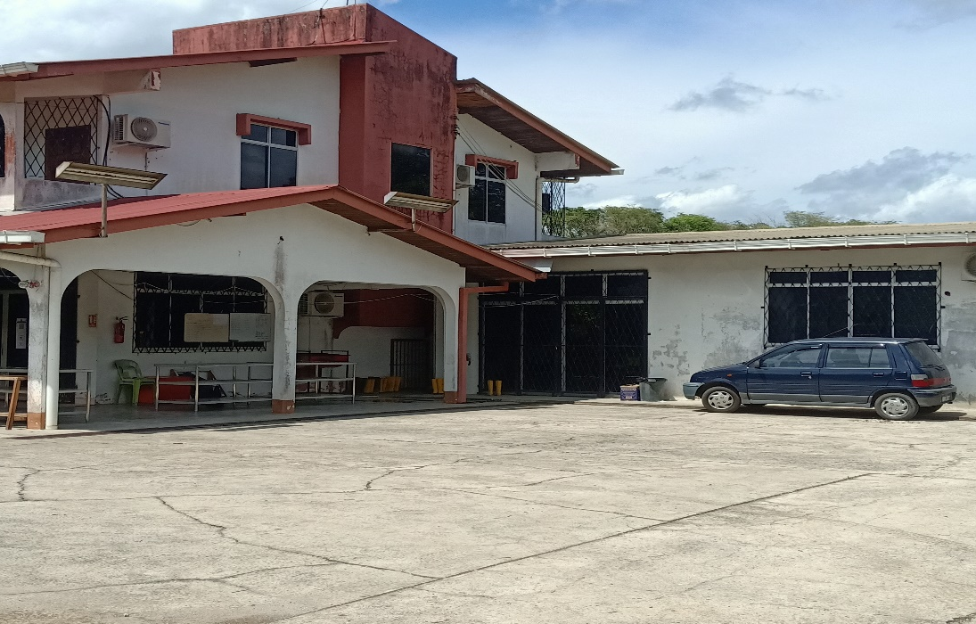
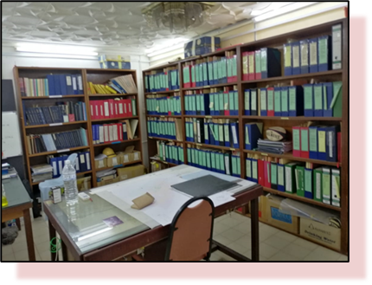
BAU GOLD PROJECT – RECOMMENCED OEPRATIONS
Drilling commenced in November 2021 with two rigs drilling Jugan.
Rigs to move to Pejiru and Bekajang sectors at Bau as part of the 3,000m-4,000m program through mid 2022.
Besra’s Bau township office reinstated, with new lease negotiated, new geological sampling and storage facilities constructed.
Re-established general administration, local communications, high speed internet, cloud based and on-site back-up for its substantial data-base.
Introduced public health care protocols for employees and contractors.
Undertaken community and landowner access consultations.
Appointed Bau based Office Manager & Administrator, a former Besra employee.
Environmental Impact Assessment commenced in relation to Jugan Project’s ML 1/2013/1D.
5

Slide 8

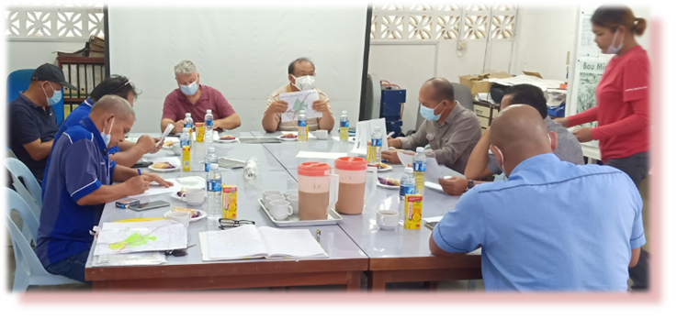
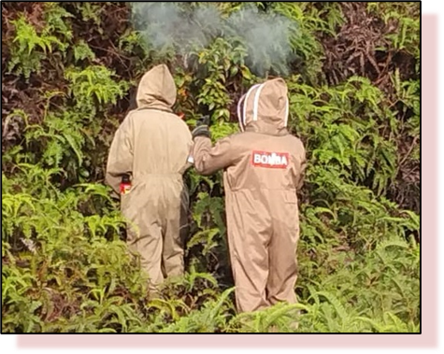
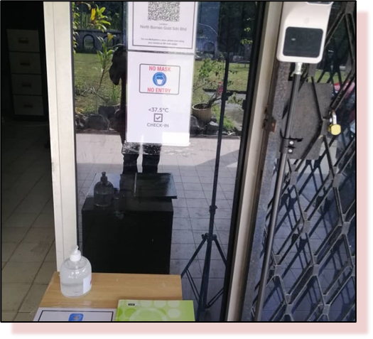
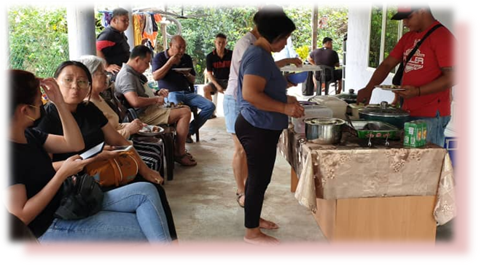
BAU GOLD PROJECT – RECOMMENCED OPERATIONS
6

Slide 9
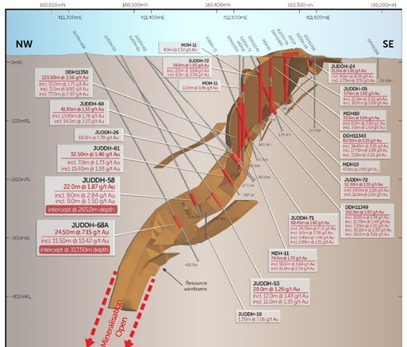
BAU GOLD PROJECT – JUGAN DRILLING
Infill and step-out drilling focusing on increasing resource inventory and classification within the shallow crestal area.
Bau based Geoimpact Services contracted for geological and logistical support - currently a team of 11, including geologists, technicians, field assistants and community liaison officer
Completed 7 fully-cored holes (JUDDH 82,83,84,85,86,87 & 88) for a total of +750m of drilling.
Currently drilling JUDDH 89 & 90 with three holes of the Jugan program remaining.
Samples from JUDDH 82, 83, 84 & 85 despatched to SGS for assay analysis in December 2021 – within two months of listing.
Samples for JUDDH 86, 87 & 88 currently being prepared for despatch for assay analysis.
Assay results expected from approx. January 2022.
7

Slide 10
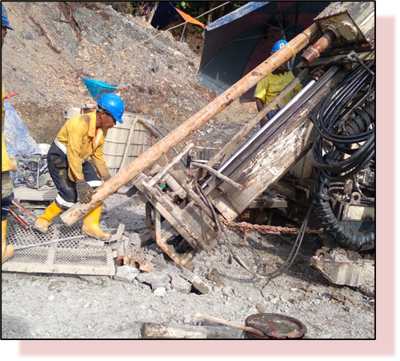
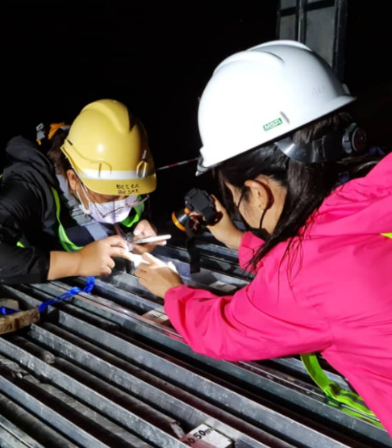
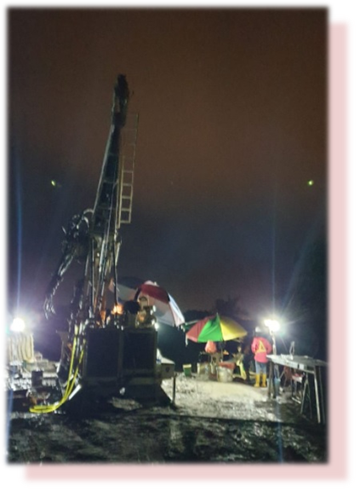
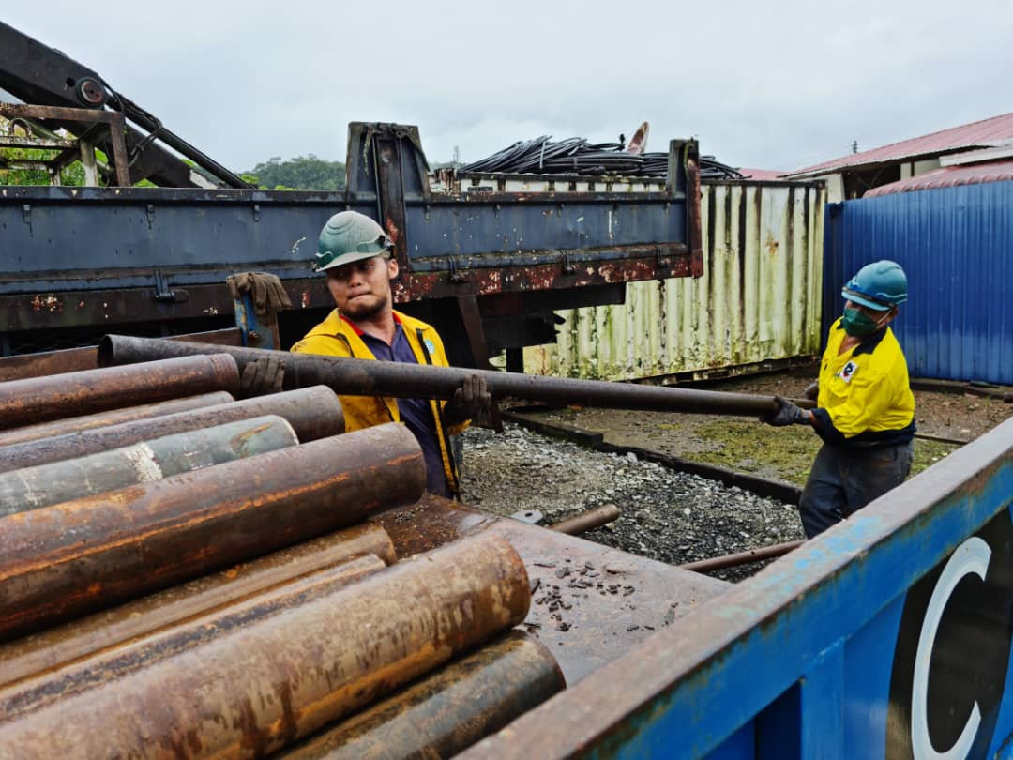
BAU GOLD PROJECT – JUGAN DRILLING
8

Slide 11
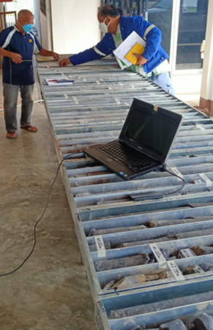
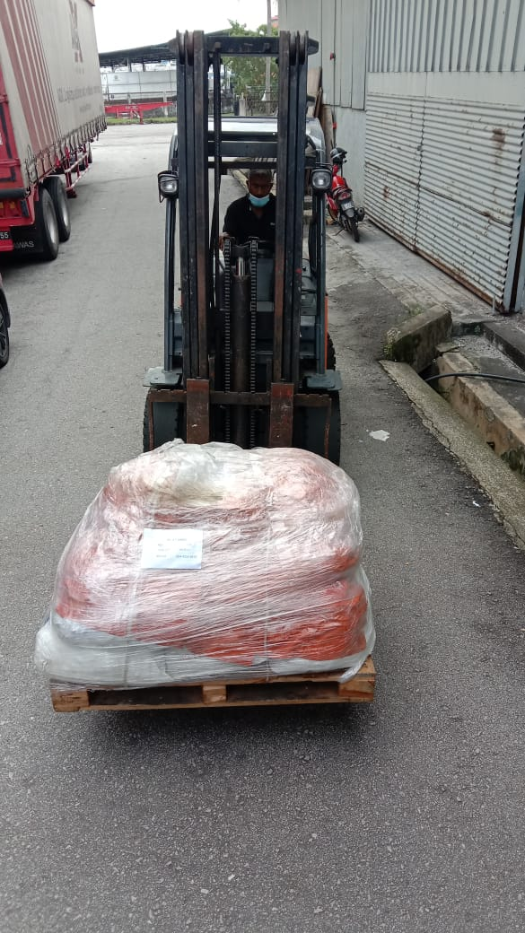
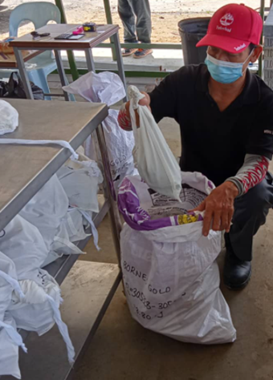
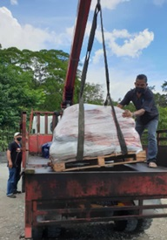
BAU GOLD PROJECT – JUGAN DRILLING
9

Slide 12
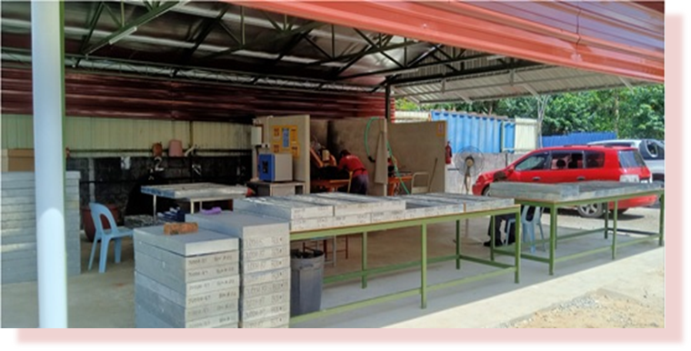
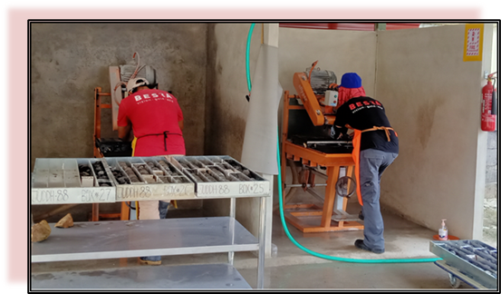
BAU GOLD PROJECT – 2022 OUTLOOK
Regular drilling results:
  Jugan – increasing shallow, high grade mineralisation in ML 140, as well as deeper mineralisation associated with plunging limb within ML 1/2013/1D. Reconnaissance drilling of the A 12 Prospect.
  Pejiru – increasing the overall resource classification and following up higher grade depth extensions at Kapor and Boring, including potential non-refractory mineralisation.
  Bekajang – Delineation of mineralisation beneath the tailings dam and investigation of mineral potential of deeper conductivity anomalies.
  Sirenggok – follow up and investigation of porphyritic mineralisation associations.
Mineral Resource – revised following 2021/2022 drilling campaign.
Jugan Environmental Impact Assessment
Jugan Pilot Plant – for bulk sample metallurgical and processing plant studies.
Jugan Feasibility Study – revised resource estimate, mineralogy assessment and metallurgical testwork to drive mine planning and plant design
10

Slide 13
Bau Gold Project – Summary
Solid foundation with existing 3.3 Moz Au Resource inventory.
Low-risk value accretive “brownfields” drilling program underway including 4.7-9.3 Moz Exploration Target¹
Feasibility studies and permitting - to be initiated in 2022 to assess mine development
Experienced team with strong local knowledge
Stable jurisdiction, with easy access to infrastructure
11
1. The potential quantity and grade of the Exploration Targets is conceptual in nature; there has been insufficient exploration to estimate a Mineral Resource and it is uncertain if further exploration work will result in the estimation of a Mineral Resource.

Slide 14

Thank you
Contact Details for further information:
Ray Shaw:
(+61) 419 413 533
John Seton:
(+64) 21 989 717
Besra Gold Inc
ASX:BEZ - ARBN 141 335 686
45 Ventnor Avenue
West Perth, Western Australia 6005
Besra (Accipiter virgatus), also called the besra sparrowhawk, occurs throughout southern and eastern Asia. It is a medium sized raptor with short broad wings and a long tail making it very adept at manoeuvring within its environment and an efficient predator.
12

